Slide 1
WELCOME IBM COGNOS analytics
Presented by
A.Muhilarasan
m.manish

Slide 2
EduConnect: Enhancing College Management through Star Schema Analysis
College Insights is a transformative project designed to enhance college management systems by leveraging a star schema data model. This project integrates diverse data sources, including student records, course enrollment, faculty information, and administrative data, to provide real-time insights and actionable recommendations. By analyzing this comprehensive dataset, College Insights enables colleges to make informed decisions in critical areas such as student performance tracking, resource allocation, scheduling, and institutional planning. This project aims to optimize operational efficiency, improve student success rates, and enhance overall organizational effectiveness. College Insights revolutionizes college management by harnessing the power of data analysis for smarter decision-making and continuous improvement

Slide 3
Data Overview and Visualization in IBM Cognos
In this project, we collected datasets containing information on institute names, institute IDs, student names, student IDs, cities, and states from across all states in India using Kaggle. For Business Intelligence purposes, we utilized a tool called IBM Cognos, through which we aligned data with lists, cross-tabulations, and various visualizations such as pie charts, bar charts, column charts, and location charts.

Slide 4
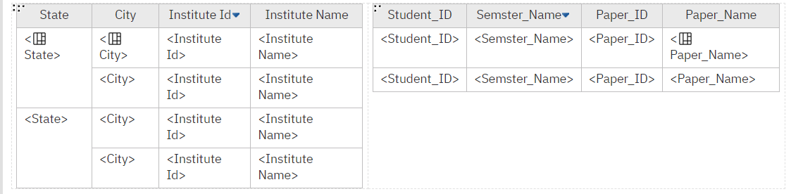
Institute Database

Slide 5
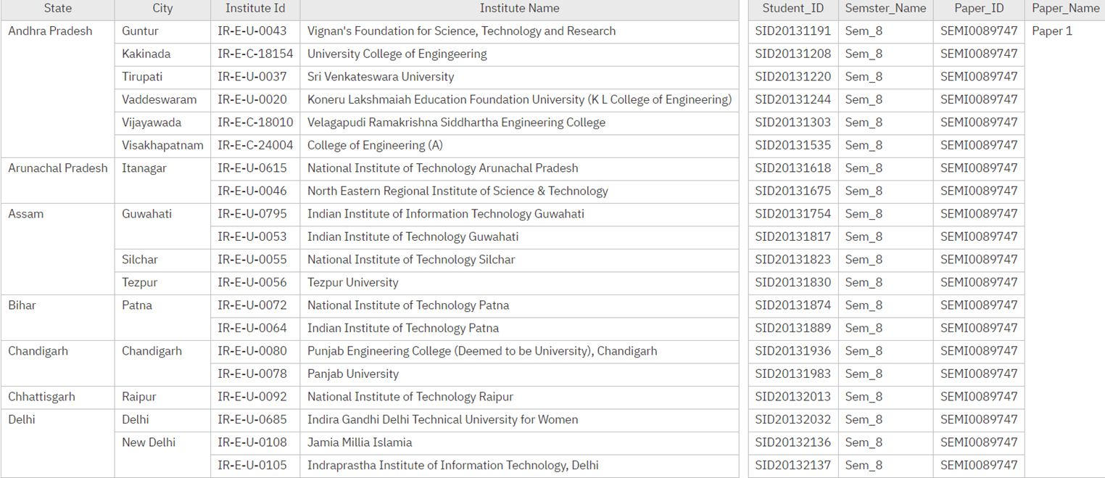
This is the desired Output

Slide 6
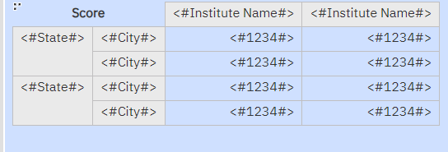
This table is used to show location of the institutions

Slide 7
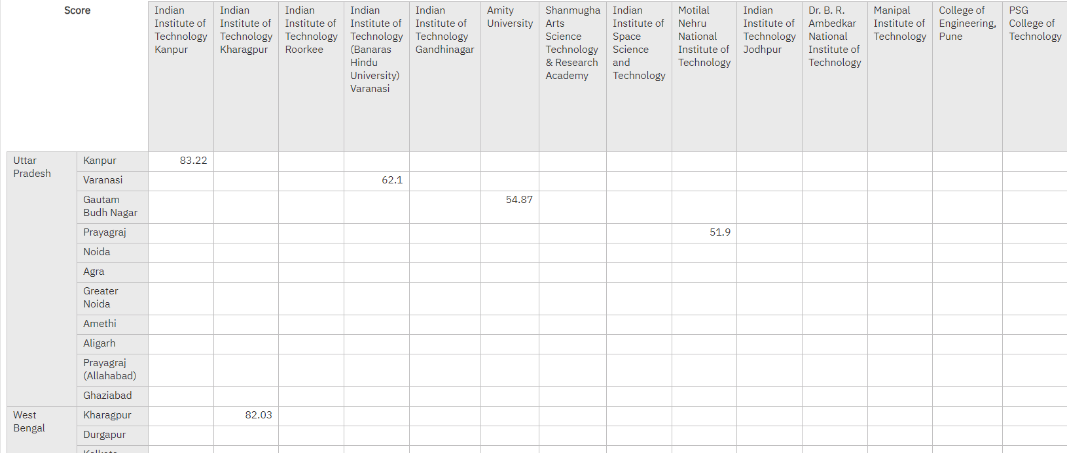
This is the desired Output

Slide 8
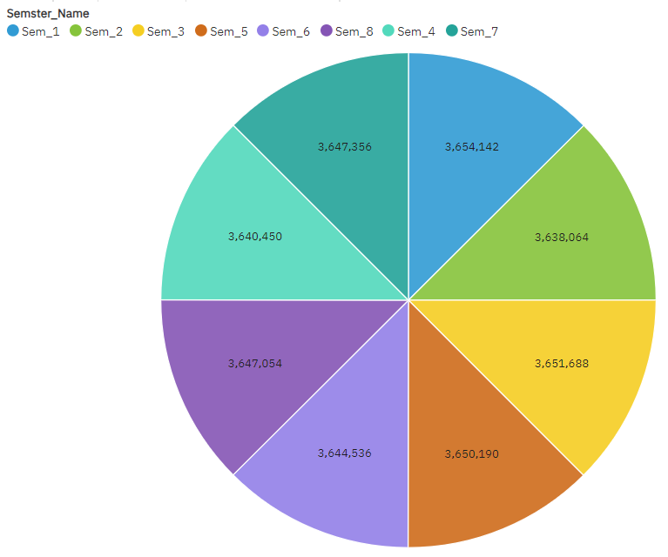
Distribution of Students by Semester
Semesters & Marks
Sem_1 – 3,654,142
Sem_2 – 3,638,064
Sem_3 – 3,651,688
Sem_4 – 3,650,190
Sem_5 – 3,644,536
Sem_6 – 3,647,054
Sem_7 – 3,640,450
Sem_8 – 3,647,356

Slide 9
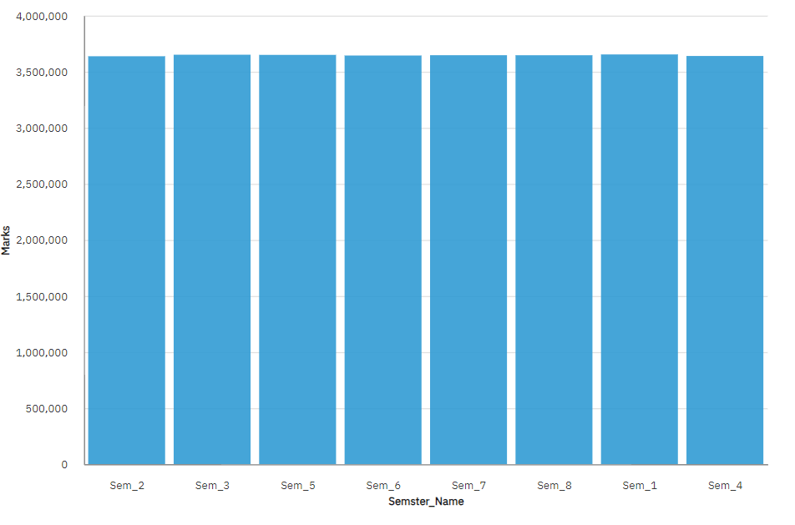
Marks Vs Semester
The slide displays a graph titled "Distribution of marks of the Students Across Semesters". The x-axis displays the eight semesters (Sem 1, Sem 2, ..., Sem 8). The y-axis displays the marks obtained by students, with a scale ranging from 0 to approximately 1,900. The graph shows a relatively consistent distribution of students across all semesters, with a slight decrease in enrollment observed in Semesters 7 and 8.

Slide 10
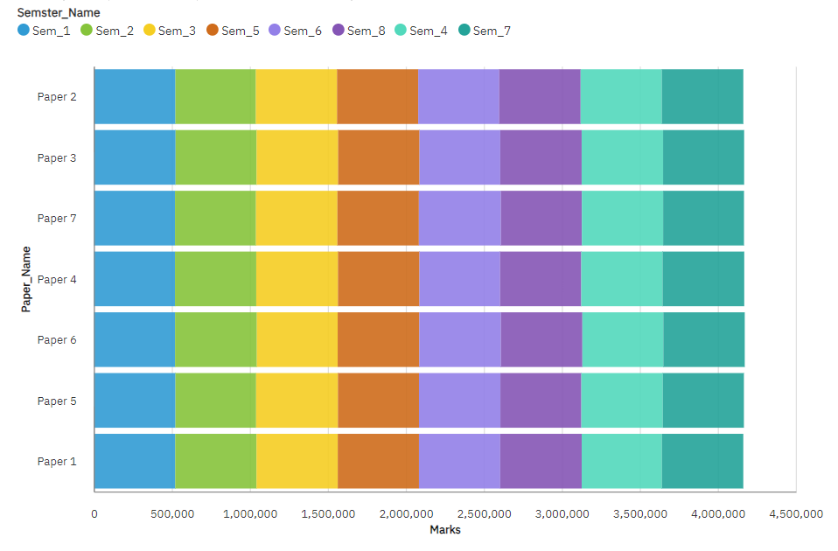
Semester-wise Distribution of Paper Submissions
The title of the graph is "Semester Name."
The x-axis labels are "Paper 1", "Paper 2", ..., "Paper 7".
The y-axis label is "Marks". The scale goes from 0 to 4,500,000.
The graph likely shows the distribution of marks across different papers within a program. It is unclear which program this data corresponds to, or the specific semester.

Slide 11
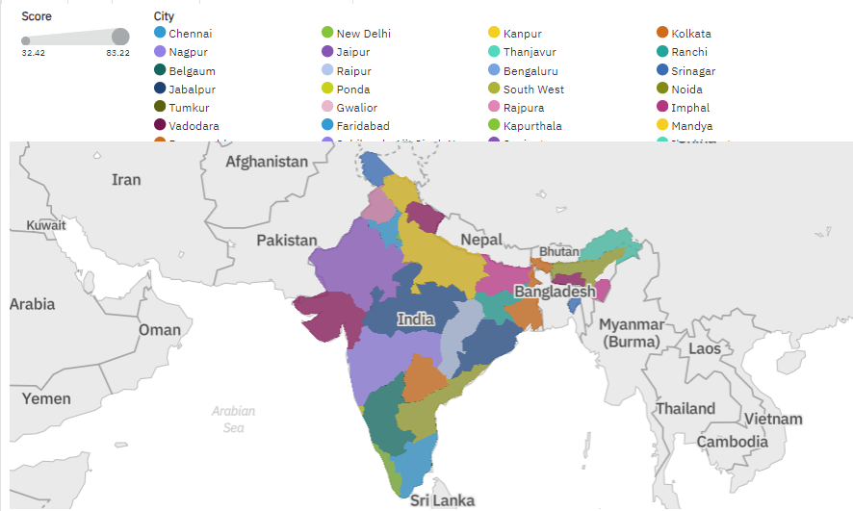
IIT Colleges where located in all over India

Slide 12
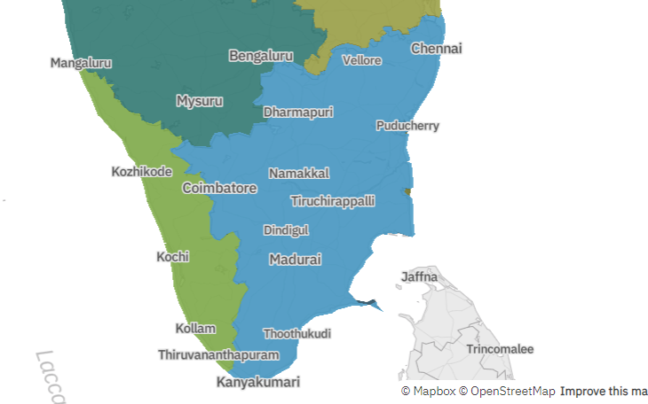
College administrative division of tamilnadu

Slide 13
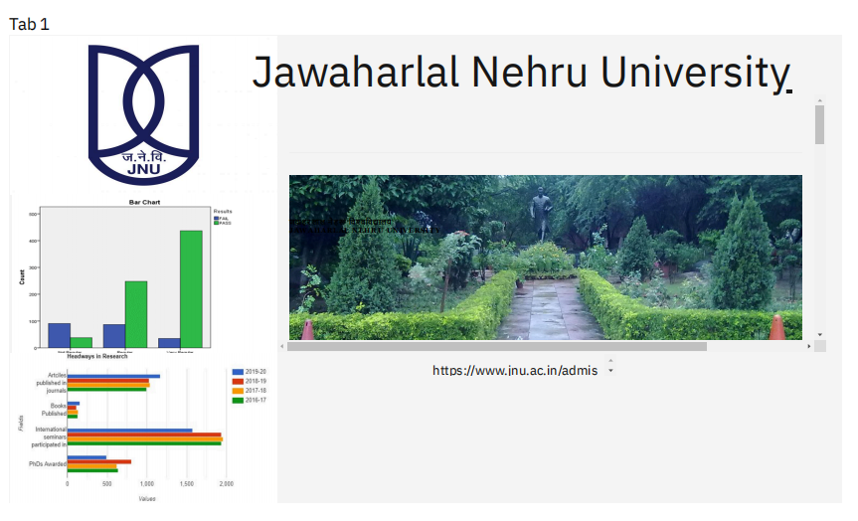
Dashboard

